Slide 1
PySpark on Jupyter Notebook
Install PySpark on Windows
Test and Demo using Jupyter Notebook

Slide 2
PySpark: Parallelize() Distribute the data across multiple nodes
Parallelize() is a function in SparkContext
Creates Resilient Distributed Datasets (RDD) from a list collection.
RDD is a data structure.
Each dataset in RDD is divided into logical partitions, each partition may be computed on a different node of the cluster.
nums = list(range(0,100000,1)
sc = sparkContext.parallelize(nums)
Creates an RDD and distributes “nums” across workers in Hadoop environment
Let’s see how this works!

Slide 3
Resilient Distributed Data: Parallelize()
Creating RDD
1
1
Python List
1
Partition-1
10
10
11
11
Partition-2
100
101
100
102
101
Partition-3
103
102
103

Slide 4
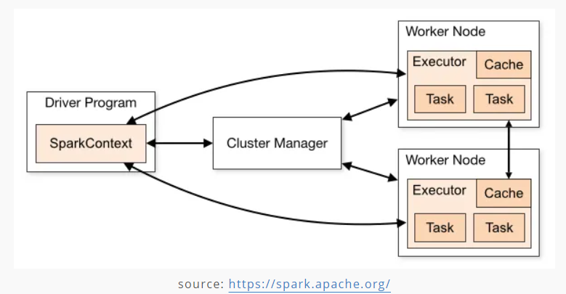
PySpark
Features
Big Data in Realtime
In-memory computing
Spark Context (SC)
Linux
Speed Caching
PolyGlot (supports several languages)
Widely used across verticals
Resilient Distributed Datasets (RDD)
sc.Parallelize()

Slide 5
PySpark with Jupyter Notebook
!pip3 install pyspark
import pyspark
from pyspark.sql import SparkSession
spark = SparkSession.builder.appName(‘Org’).getOrCreate()
sc = spark.sparkContext
Testing
numbers = list(range(0,100000,1))
#create an RDD and distribute the list across available nodes
numbers_rdd = sc.parallelize(numbers)
#list the numbers using methods
numbers_rdd.collect()
numbers_rdd.take(5)

Slide 6
Additional Materials and Tutorials
How to set up PySpark for your Jupyter notebook | Opensource.com
PySpark parallelize() - Create RDD from a list data — SparkByExamples

